Slide 1

Sakshi Choudhary, Giorgi Khmaladze, Nick Litman, Mihir Somani, Conley Utz

Slide 2
Problem Statement
College books and similar supplies are mostly very expensive. For this reason, students often try to seek out used supplies to purchase for a cheaper price. As of today there are limited markets for these types of products which specifically cater to university students. MyUniMarket will solve this problem by providing a well-built, easy-to-use, and appealing platform for reselling college supplies to Purdue students.

Slide 3
Live Demonstration

Slide 4
Testing Documentation

Slide 5
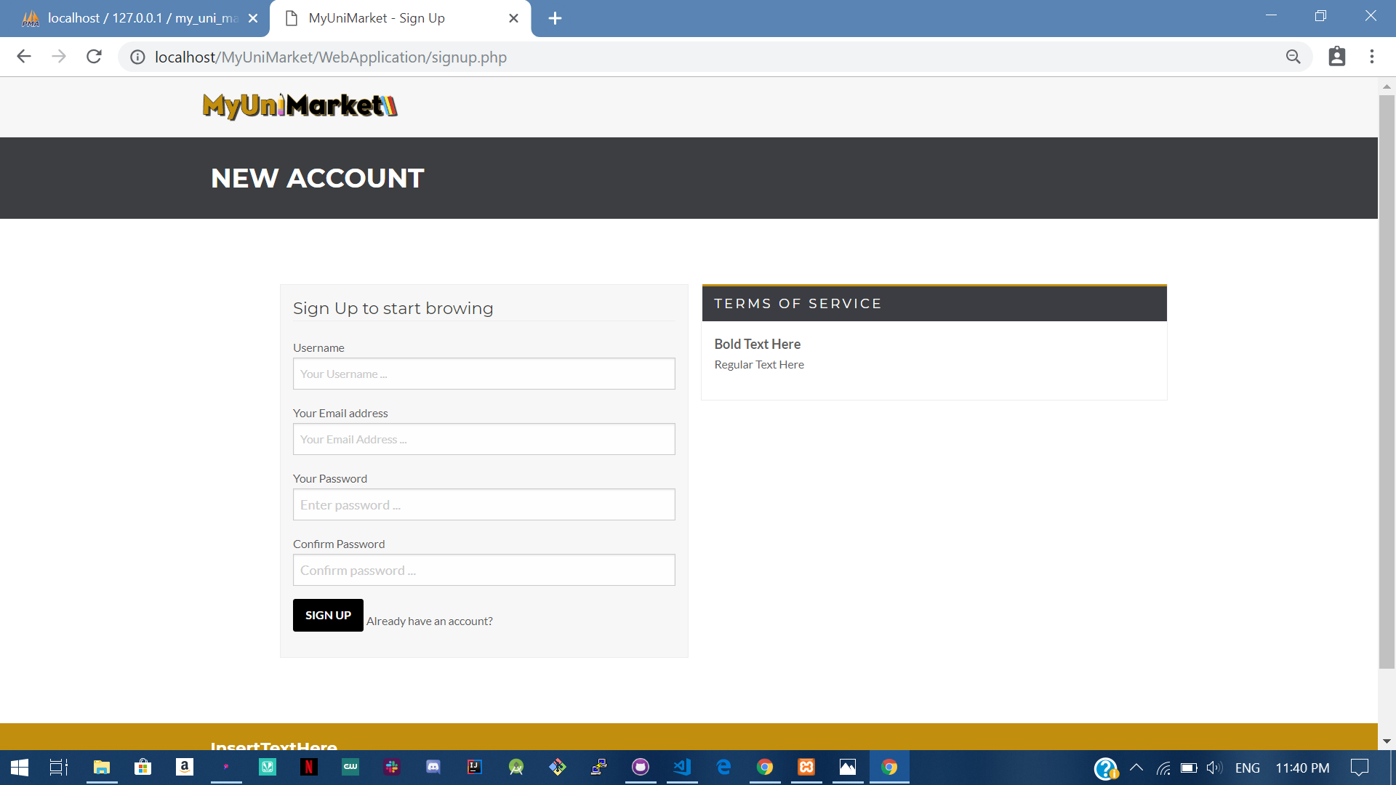
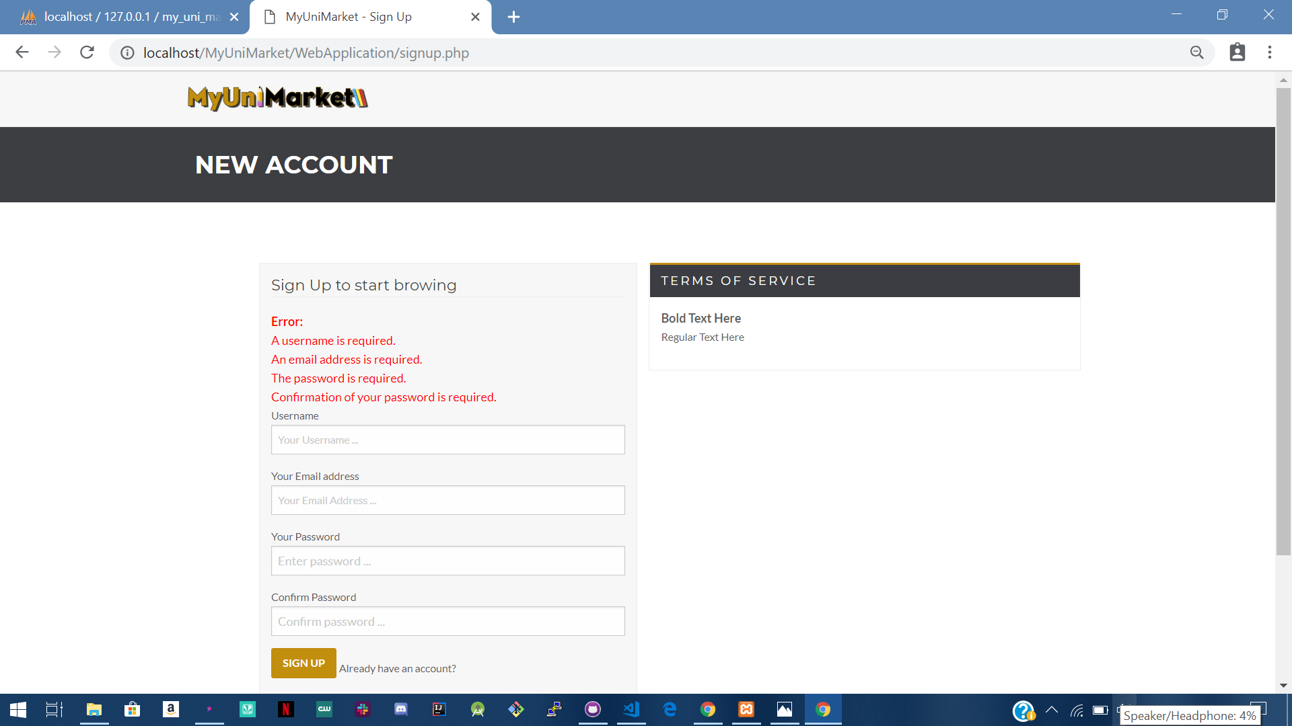
User Story #1- Required fields not filled
Before
After

Slide 6

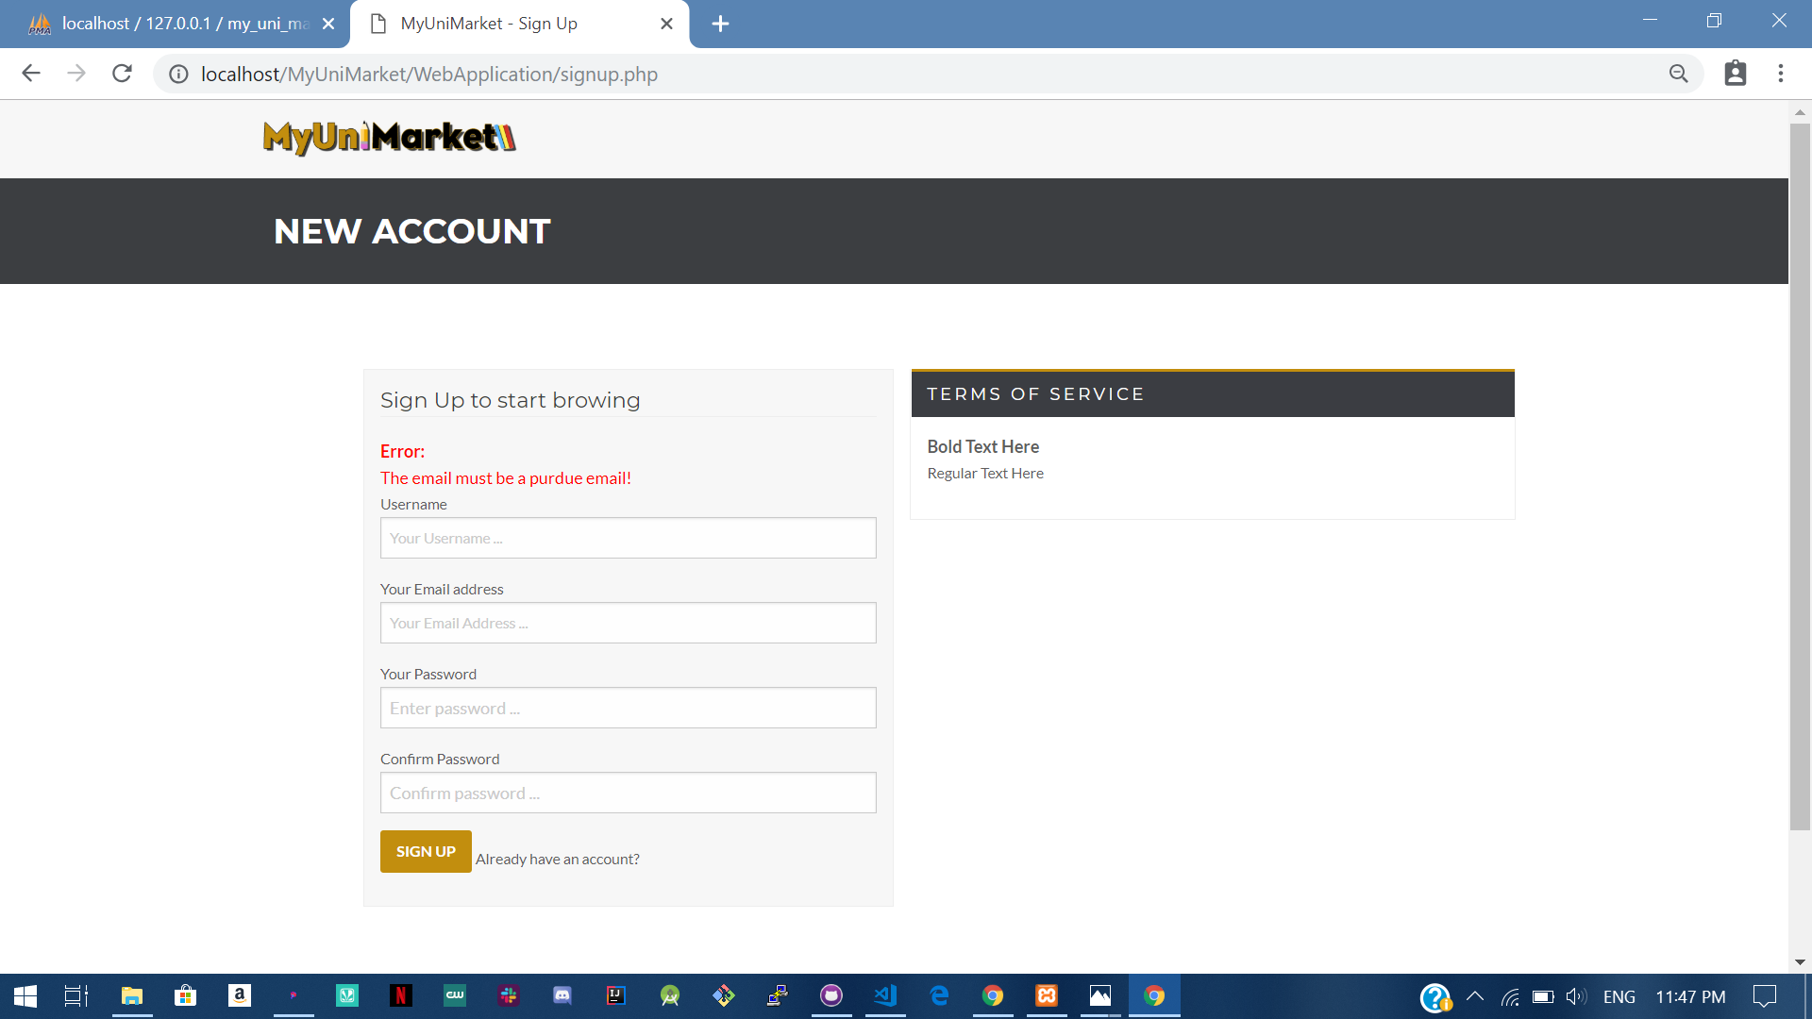
User Story #1- Non-Purdue email used
Before
After

Slide 7
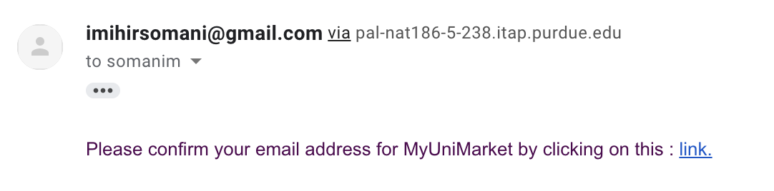
User Story #1- Purdue Email Verification

Slide 8
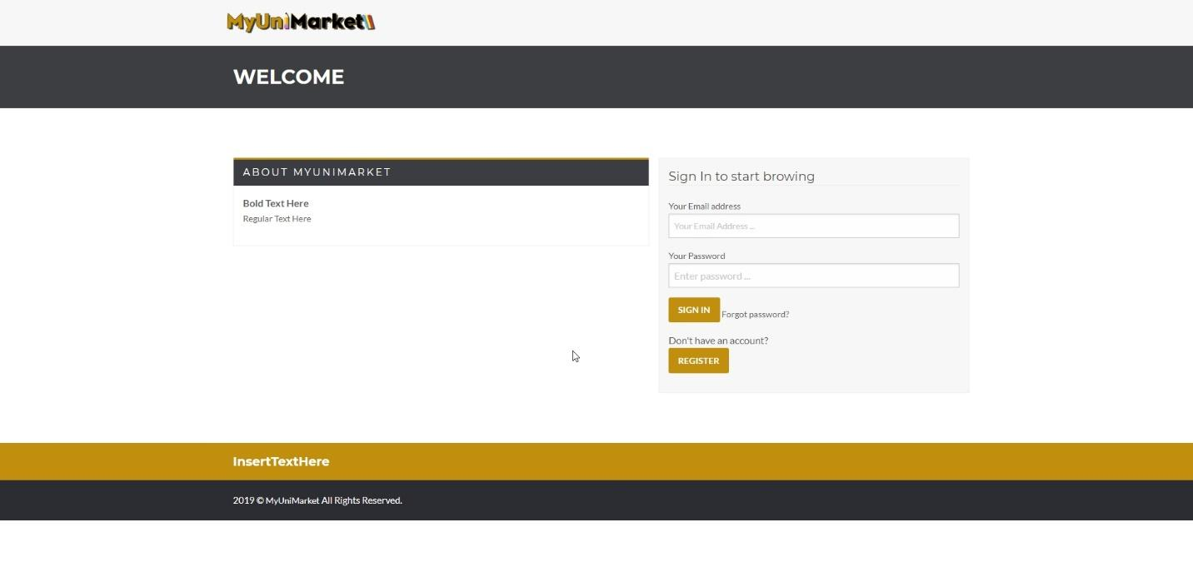
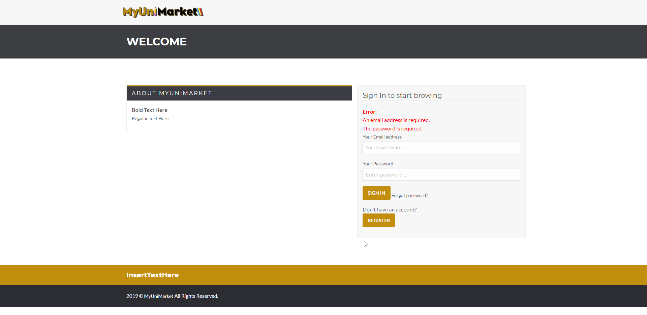
User Story #2 - Required fields not filled
Before
After
Notes:
Only covered first case of invalid input, the others are omitted to save time and should be talked about onthis slide

Slide 9
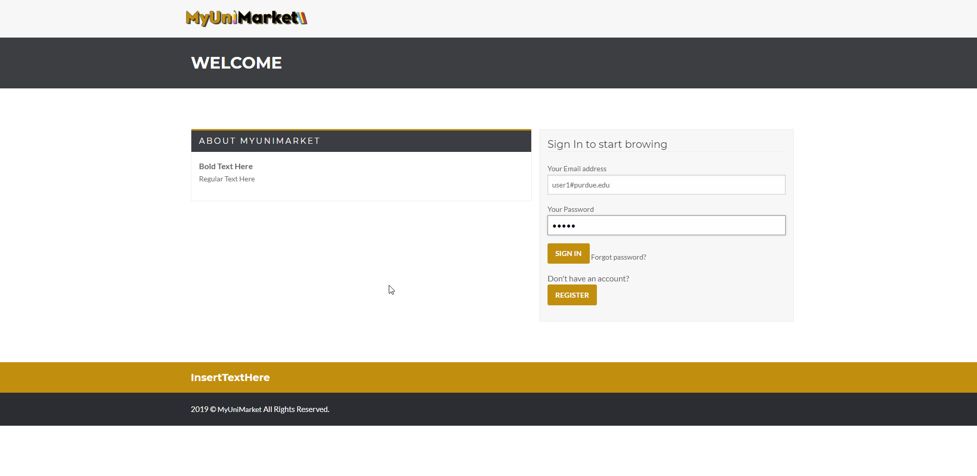
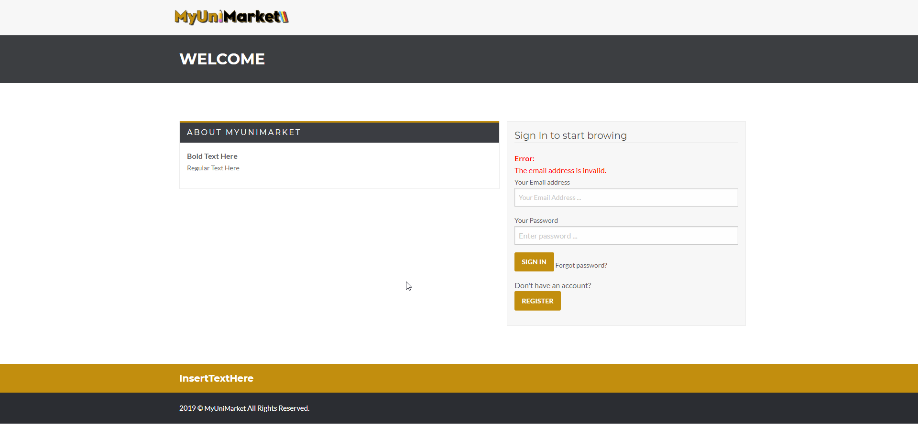
User Story #2 - Invalid input in field
Before
After

Slide 10
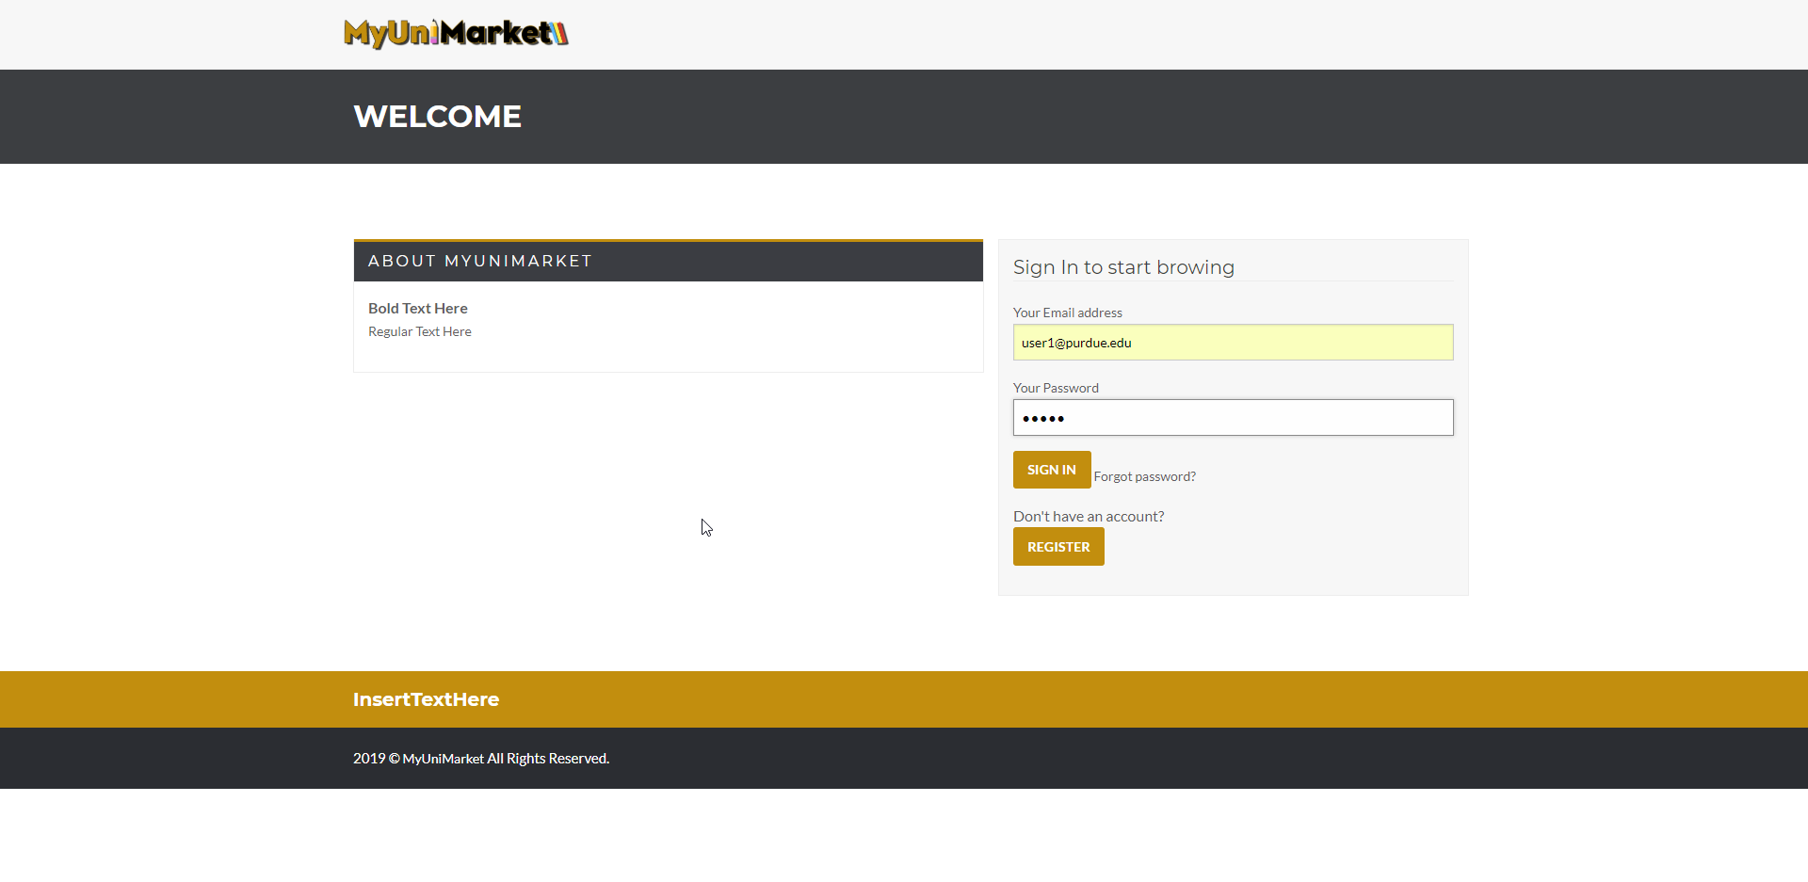
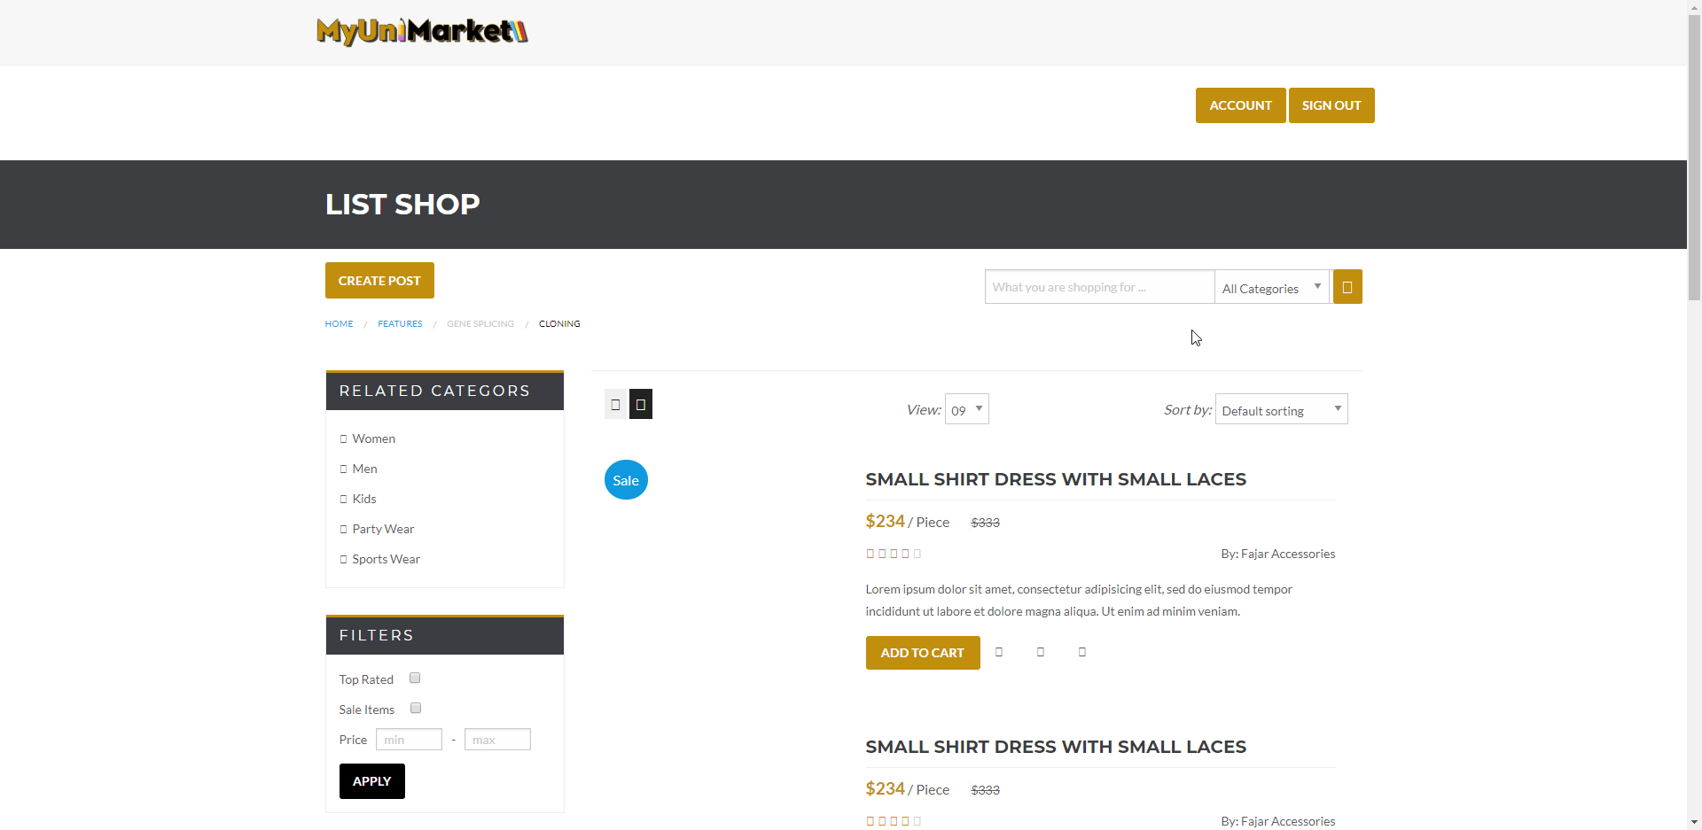
User Story #2 - Fields correctly entered
Before
After

Slide 11
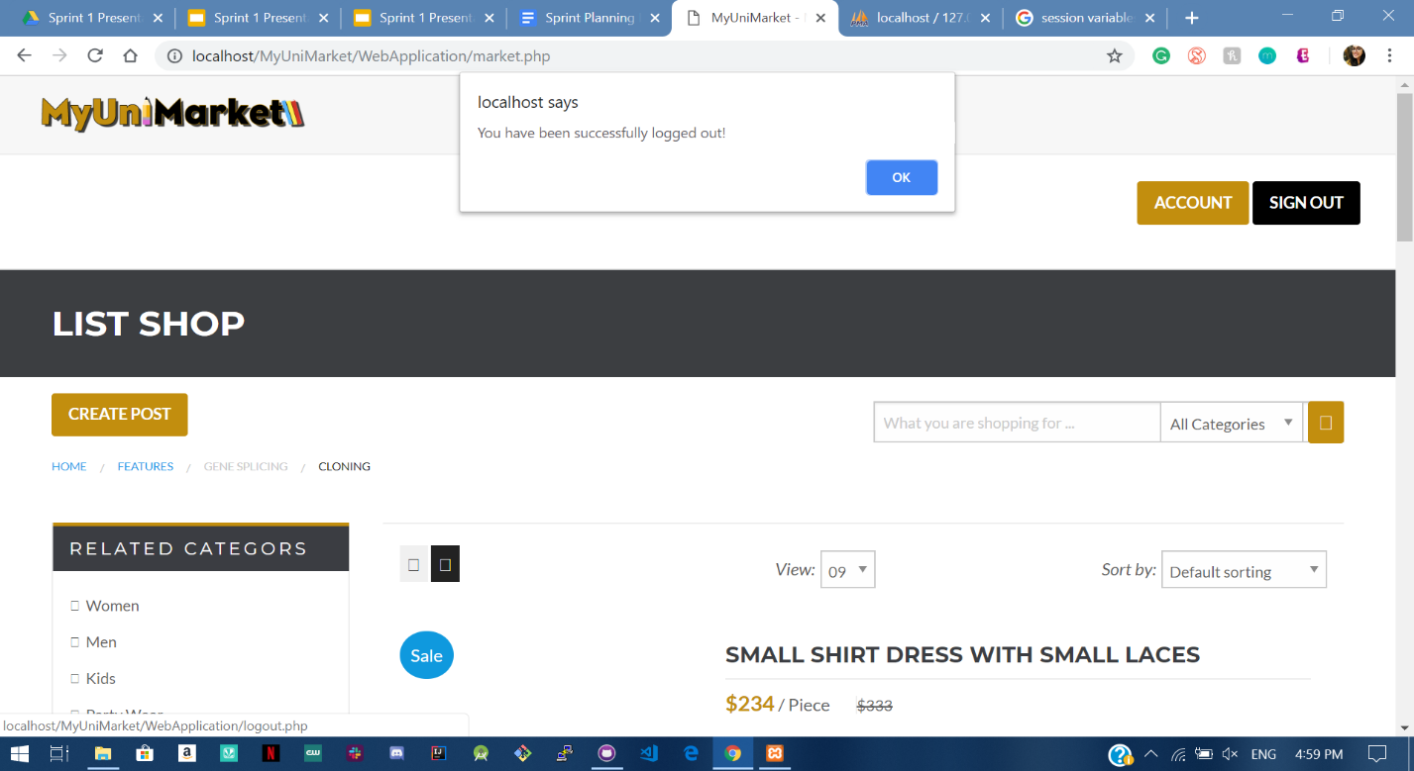
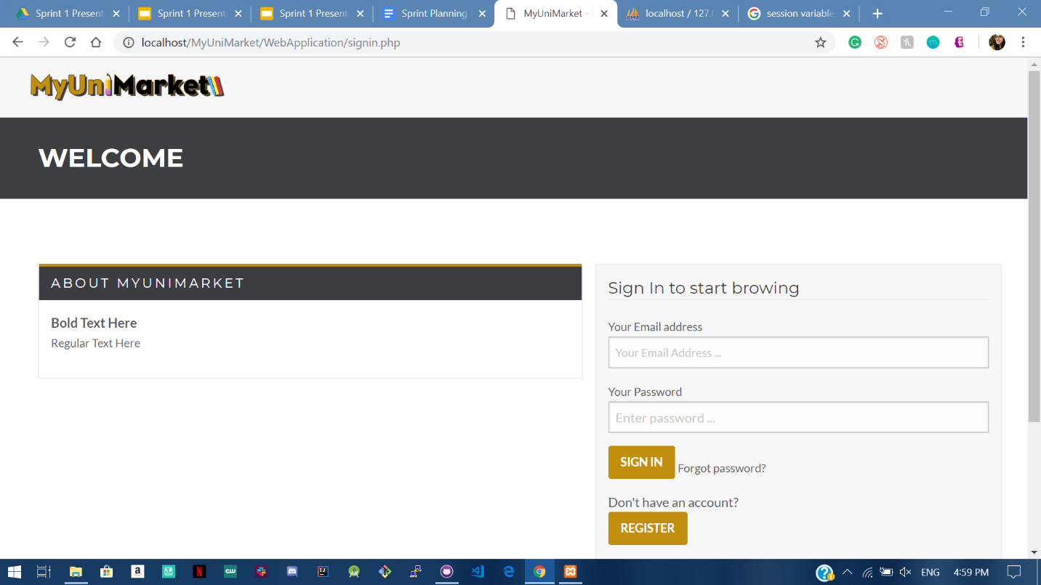
User Story #3 - User attempts to sign out
Before
After

Slide 12
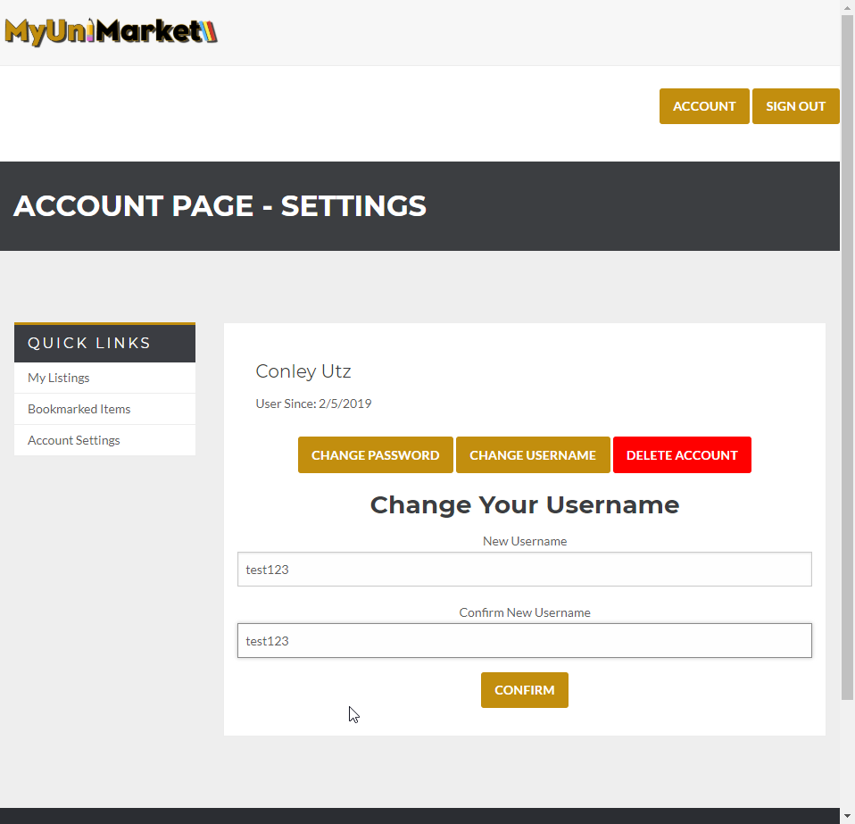
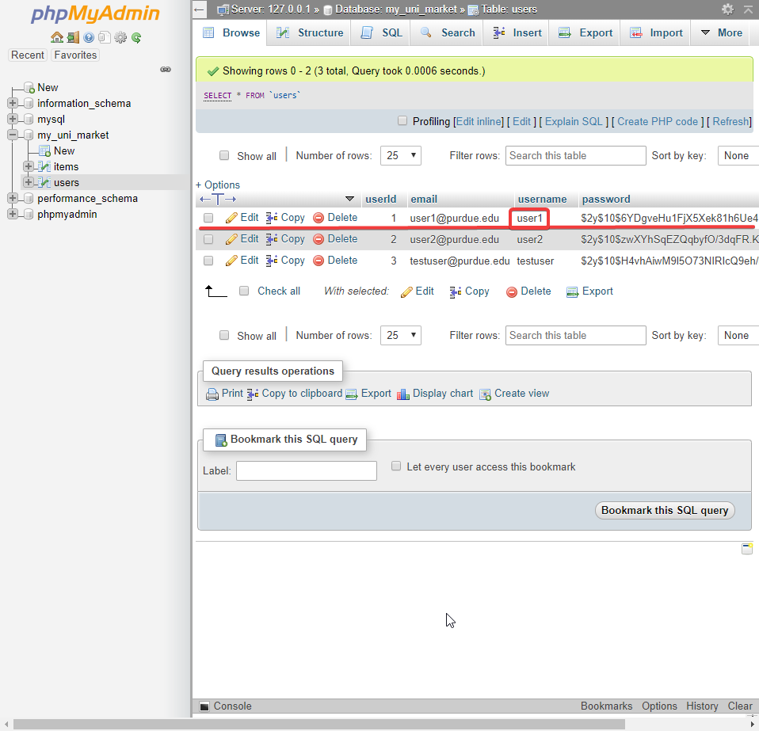
User Story #4 - User changes username
Before - Website
Before - Database
Notes:
Did not add tests for invalid input to save time as this user story is already large, this functionality can be showed in the live demo. I chose changing username and password to show that database and hashing works

Slide 13
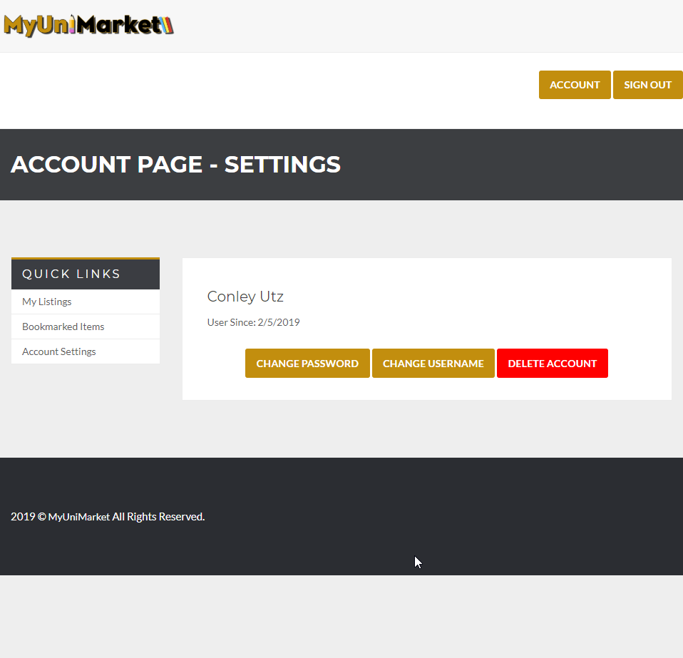
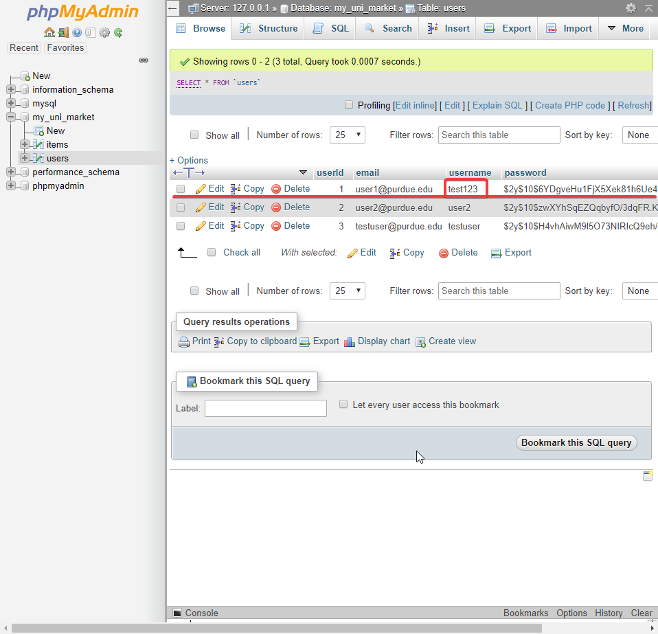
User Story #4 - User changes username
After - Website
After - Database

Slide 14
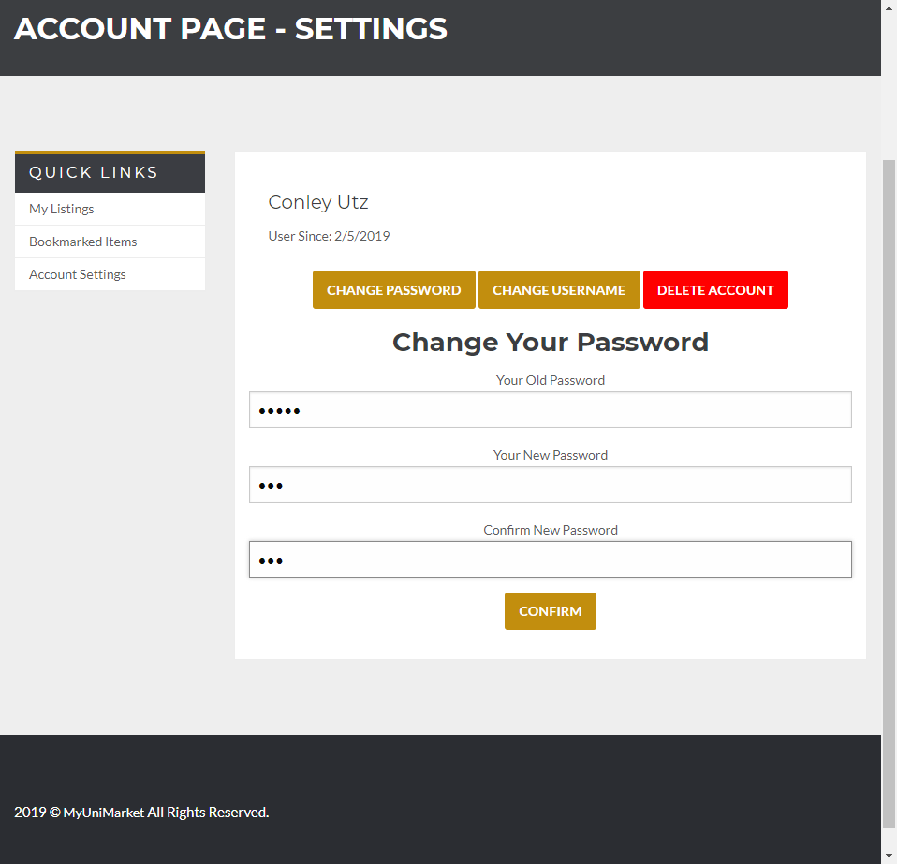
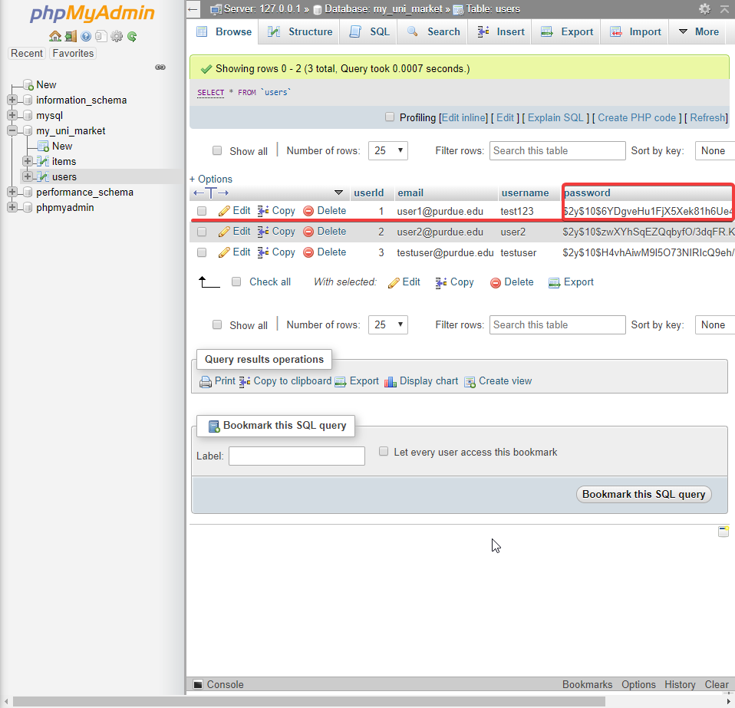
User Story #4 - User changes password
Before - Website
Before - Database

Slide 15

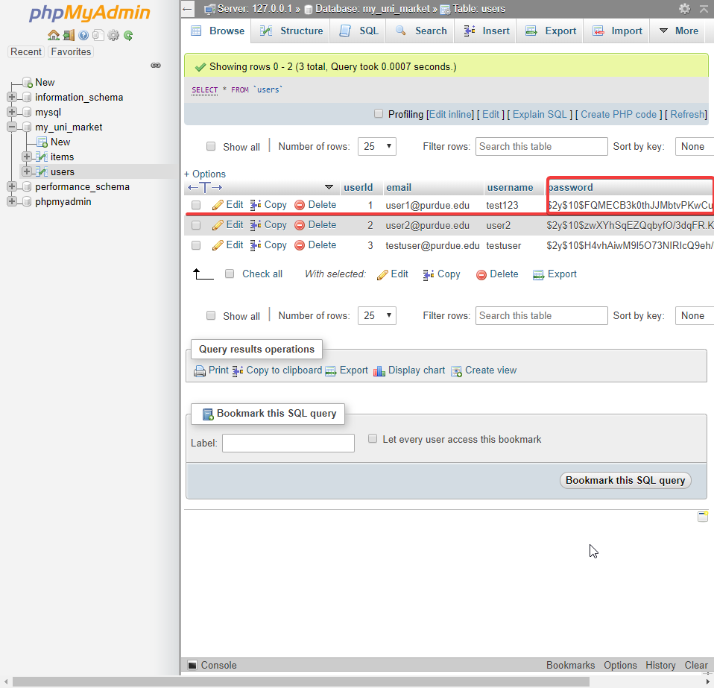
User Story #4 - User changes password
After - Website
After - Database

Slide 16
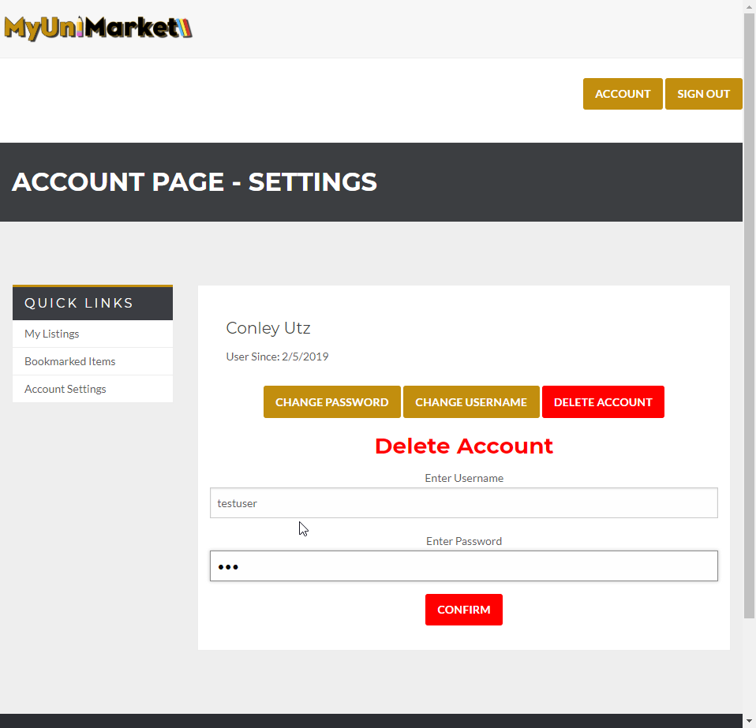
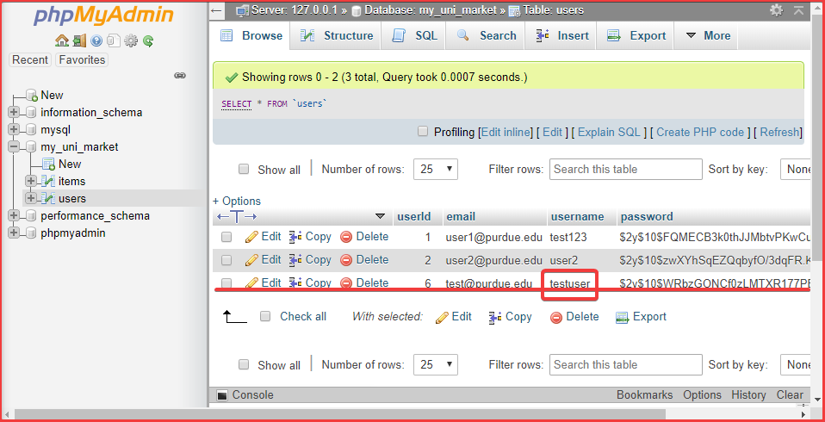
User Story #5 - User deletes account
Before - Website
Before - Database

Slide 17
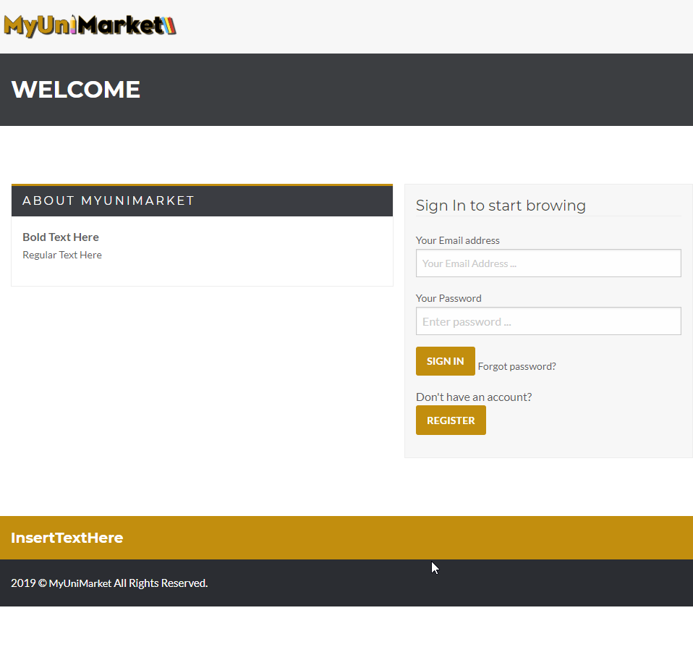
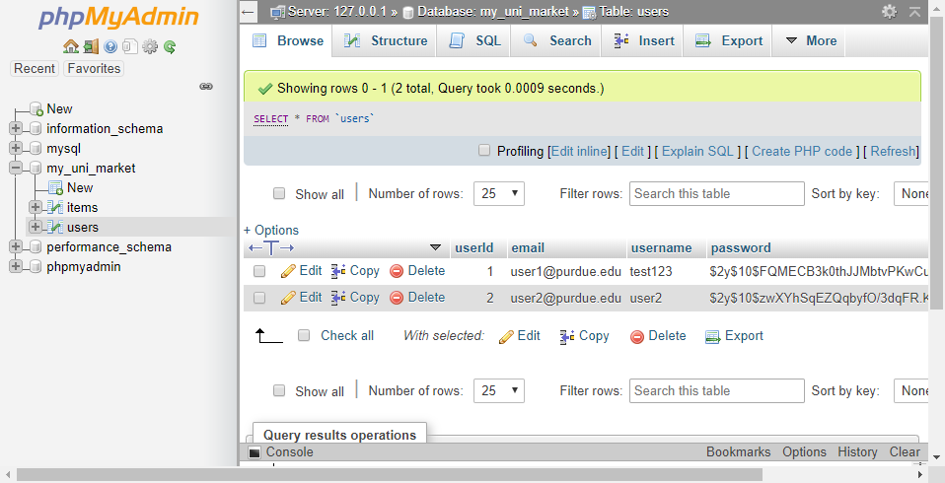
User Story #5 - User deletes account
After - Website
After - Database

Slide 18
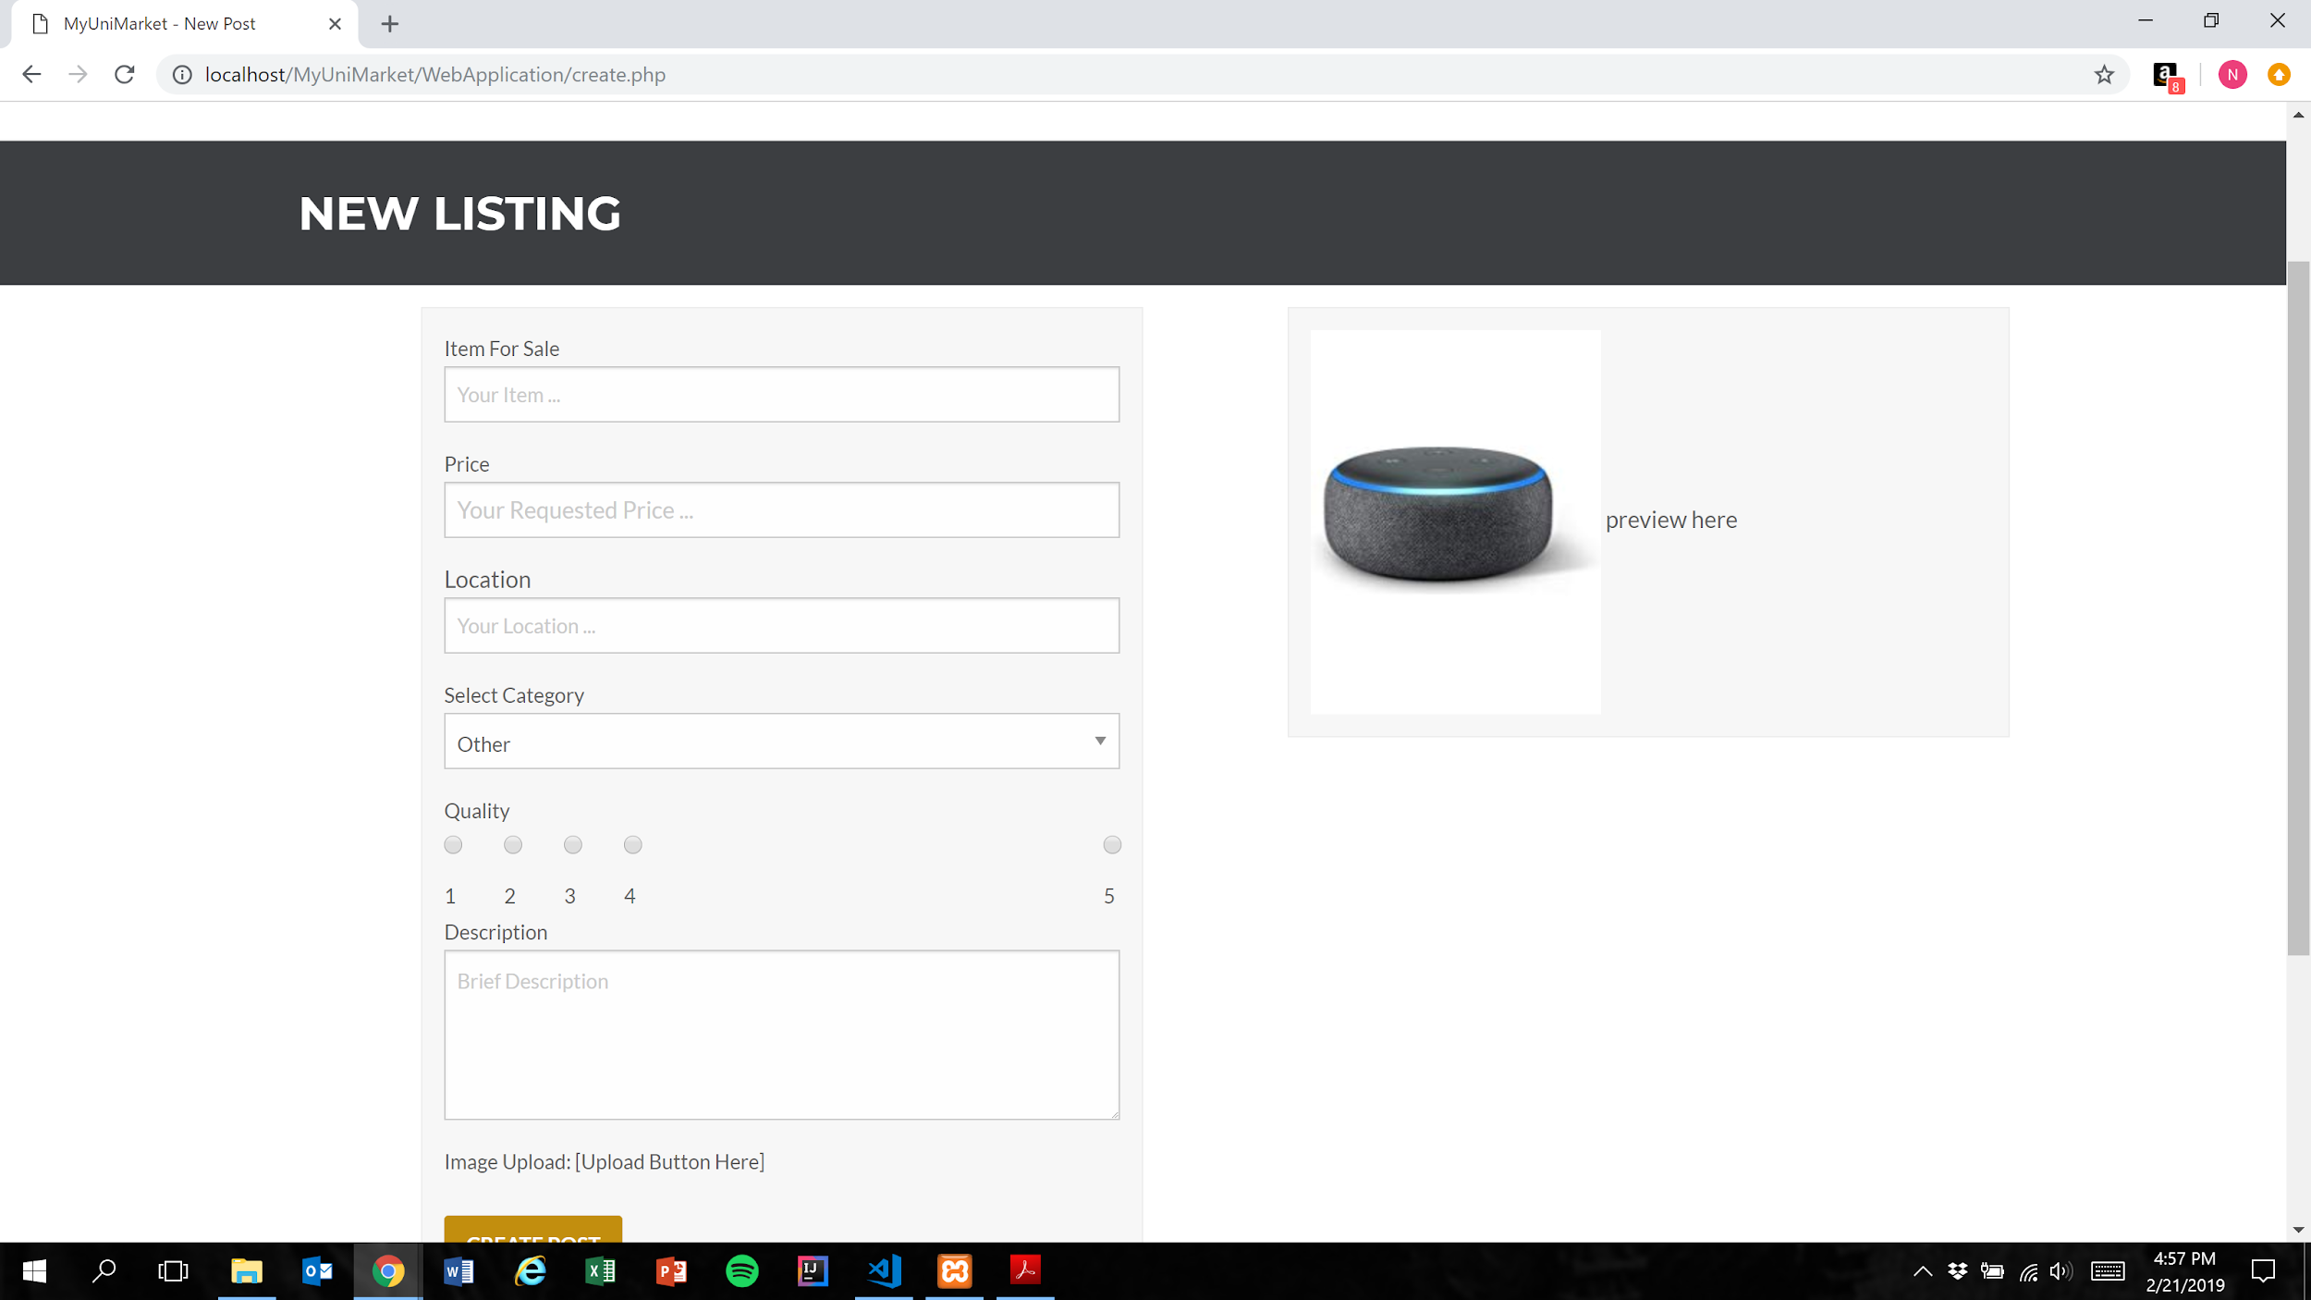
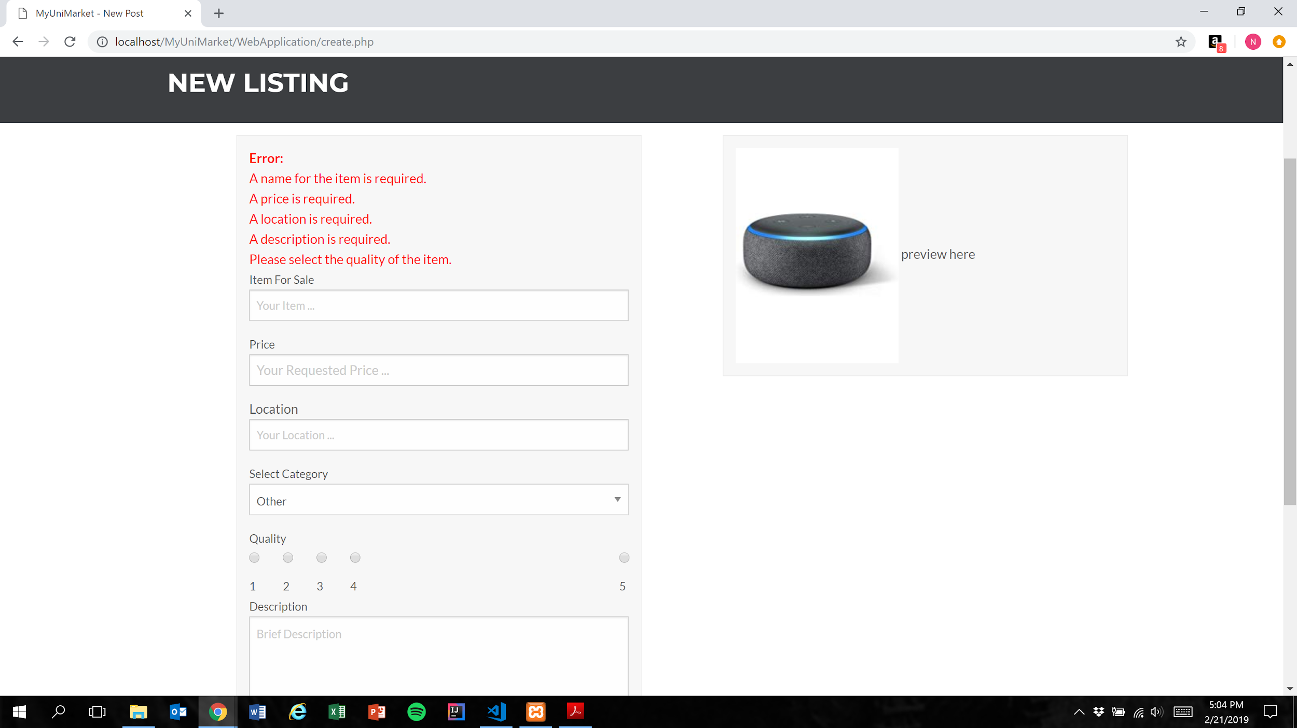
User Story #6 -User creates post with invalid input
Before
After

Slide 19
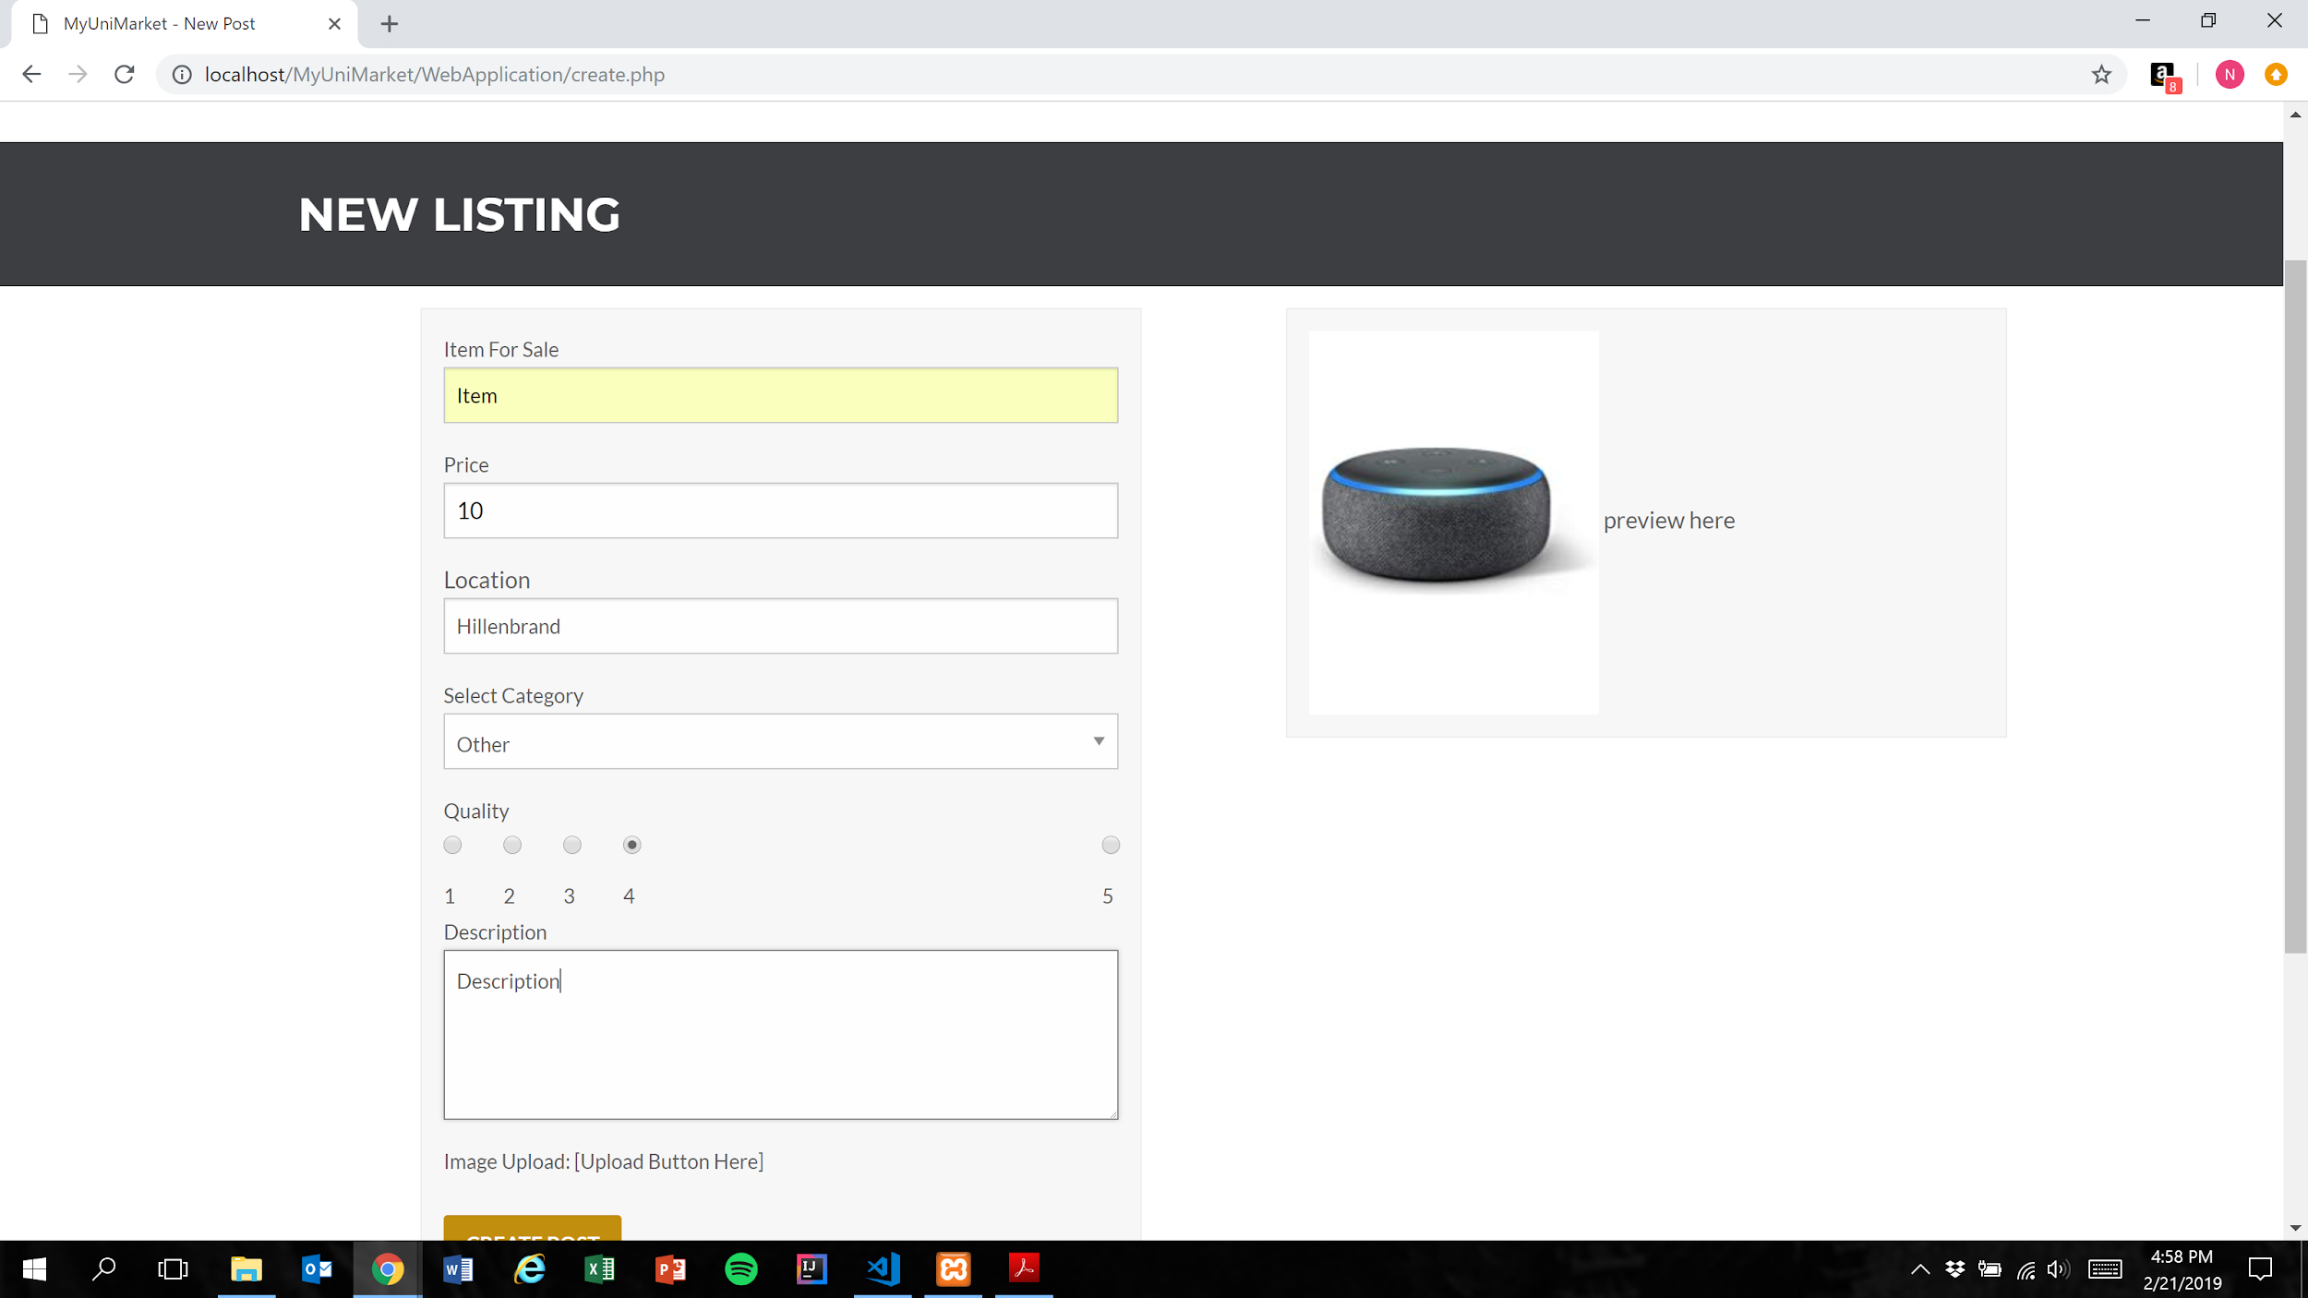
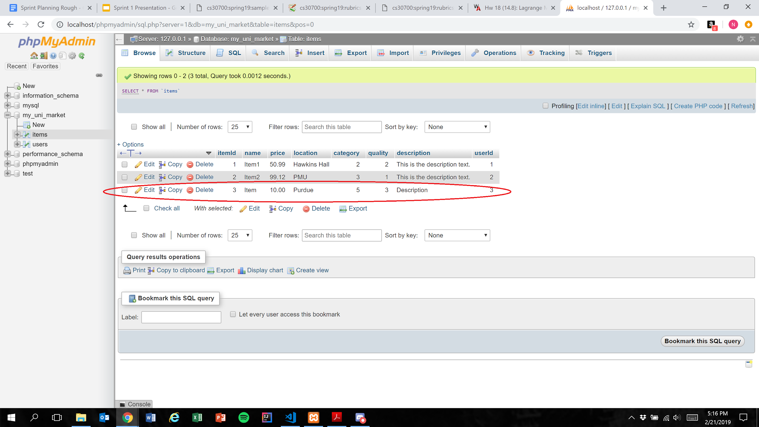
User Story #6-11-User creates post with valid input
Before
After

Slide 20
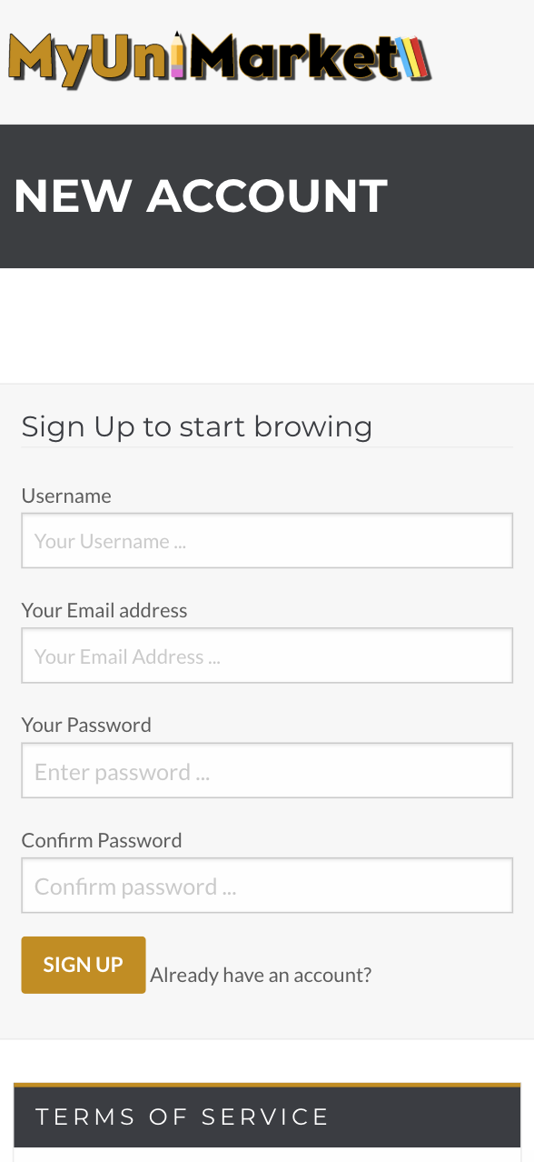
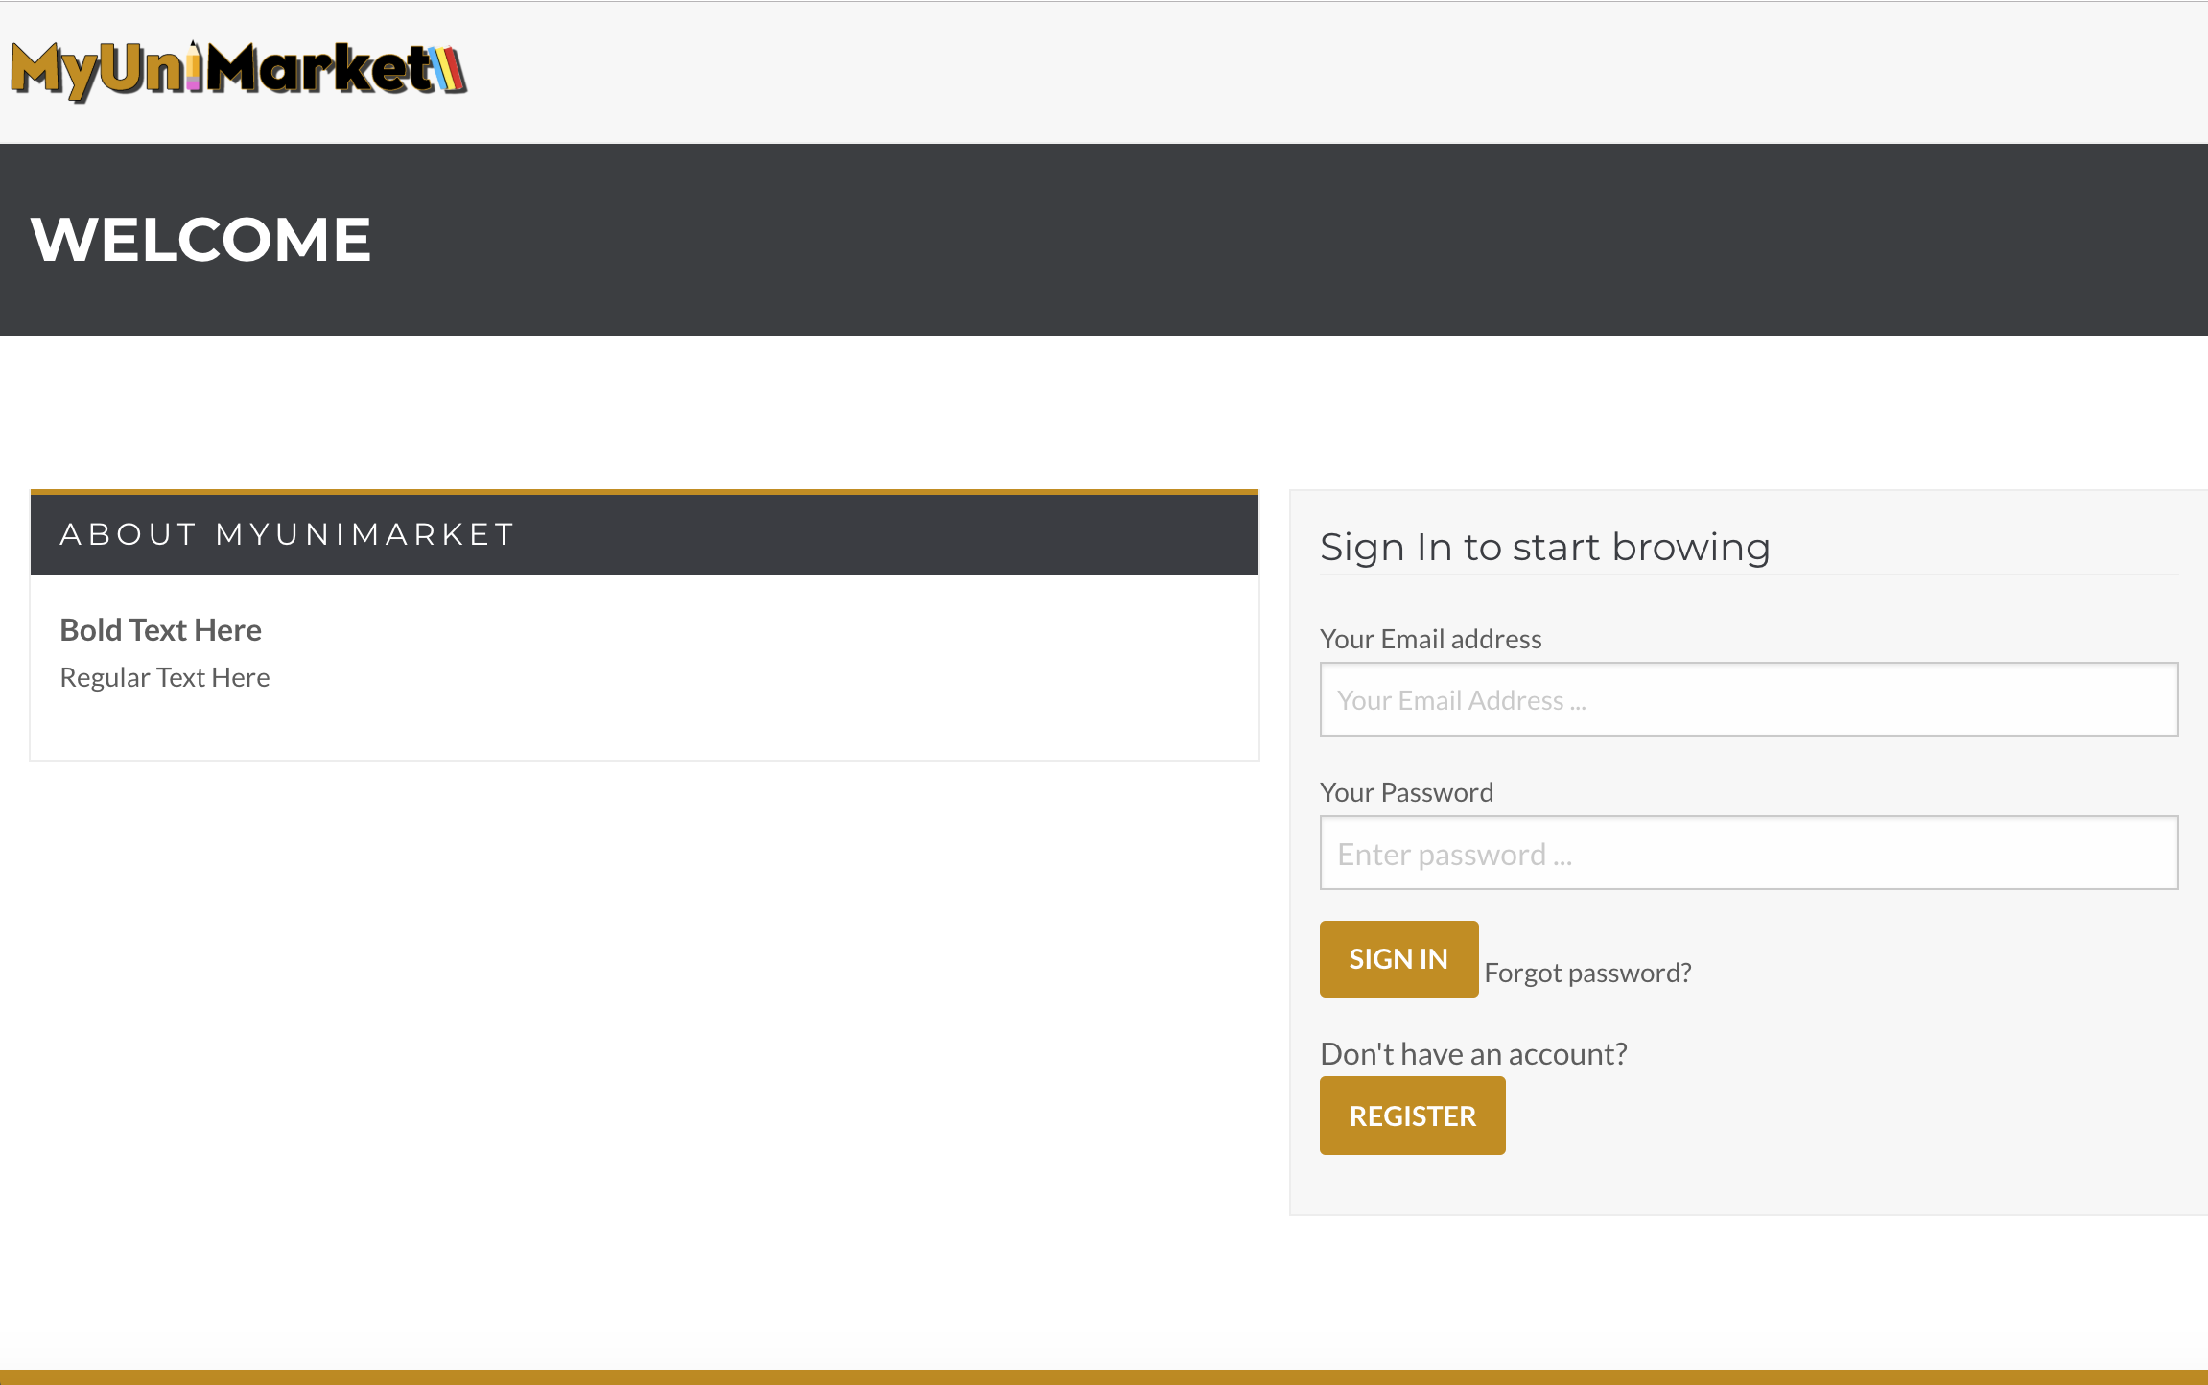
User Story #12 - Pages are viewable on all devices
IphoneX
Google Chrome on Computer
Notes:
Only included one page for example

Slide 21
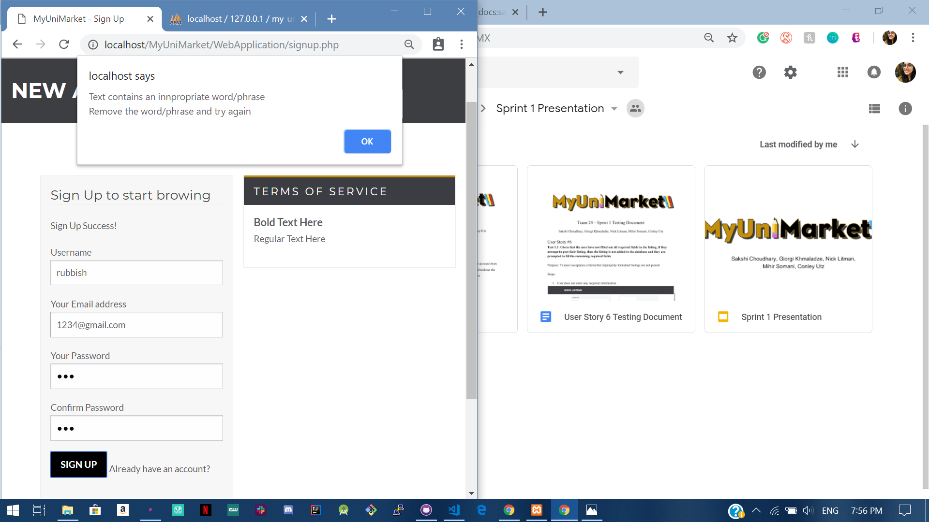
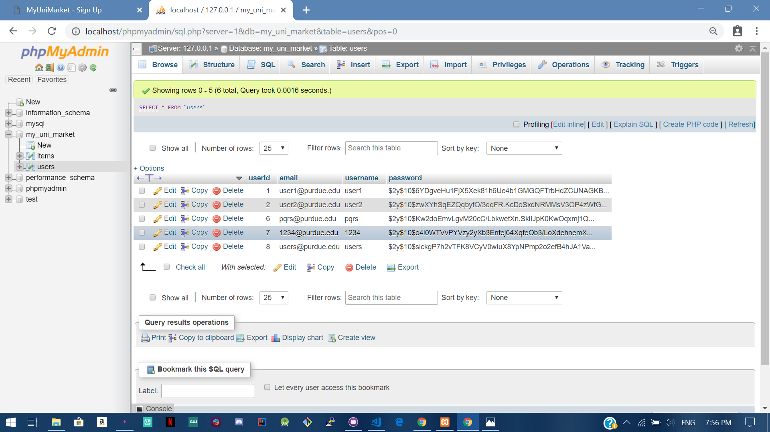
User Story #13 - Inappropriate words not allowed
Website
Database
Notes:
Only used one page for example

Slide 22
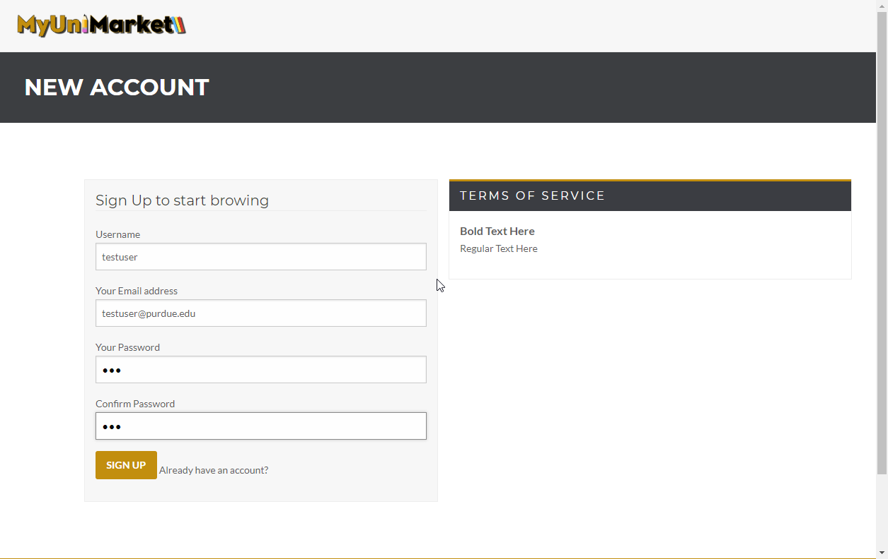
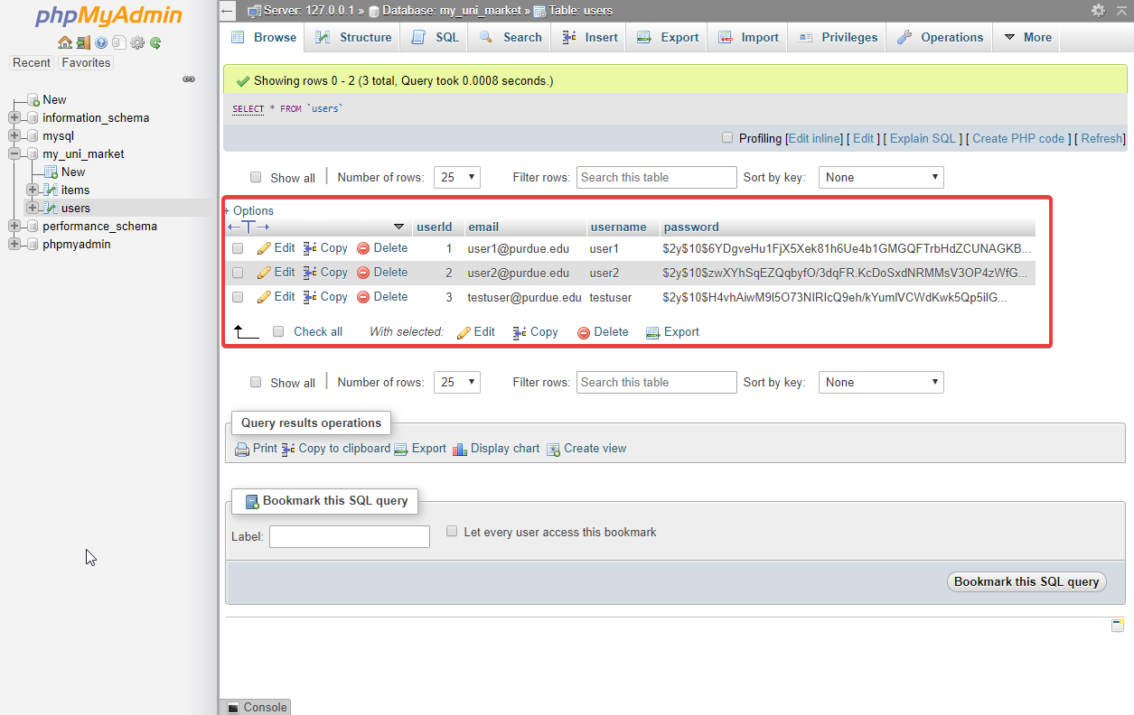
User Story #14 - Passwords are hashed in database
Before
After
Notes:
Testing password is 123

